Slide 1

Large action space end-to-end Reinforcement Learning
ShanghaiTech CS181 Final project | Final presentation
刘睿琪 Rui-qi Liu
liurq@shanghaiTech.edu.cn
86396172
秦琦 Qi Qin
qinqi@shanghaiTech.edu.cn
49407951
徐寅韬 Yi-tao Xu
xuyt@shanghaiTech.edu.cn
53533324
袁可一 Ke-yi Yuan yuanky@shanghaiTech.edu.cn
74638067

Slide 2
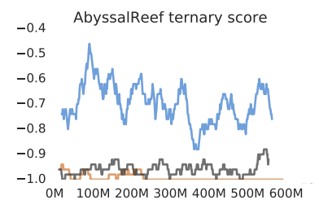
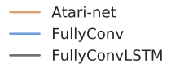
Motivation
From StarCraft II: A New Challenge for Reinforcement Learning
Baseline method indicates:
Poor result sadly.. What is the reason?
large state space
Large action space
Poor independent assumption of the probability of action
Motivation2: success of alphaGO
ShanghaiTech CS181 Final project

Slide 3
Our contribution
Provide a PVP mini-game map basing on pysc2 API.
Apply baseline DQN
Handle the large action space
ShanghaiTech CS181 Final project

Slide 4
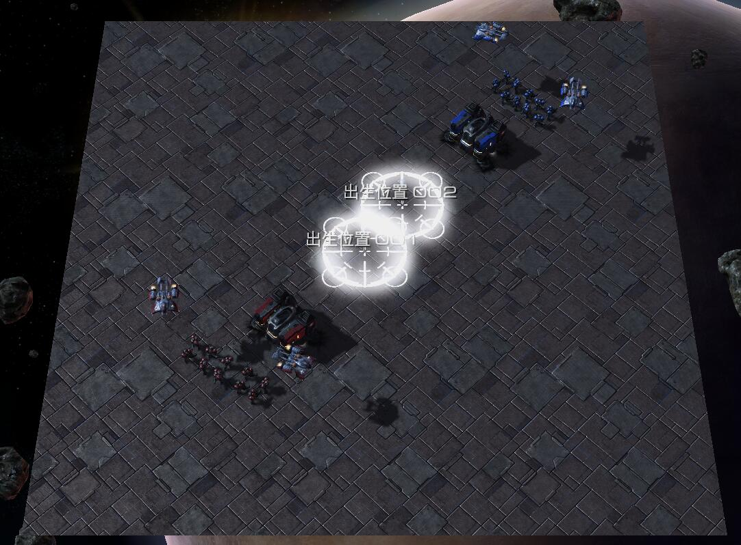
New task
raise a new practical mini-map, instead of extremely hard and complicated
full sc2 game basing on slight modification of pysc2, a deep Mind API
practical for RL-learning experiment
most of sc2 works base on how to hard-code good expertise knowledge(e.g: timing to rush, hard-code attack target evaluation function)
highly rely on human being replays
a well-tested reward system
our baseline method shows that it works
concentrate as much elements as possible
conserve attacking-training tradeoff
ShanghaiTech CS181 Final project

Slide 5
New task
Chief goal:
command your troop destroy other player’s barracks
Game setting:
Receive 10 minerals every second
50 minerals can be used to train a marine in one’s barrack.
everyone has his/her initial troop
ShanghaiTech CS181 Final project

Slide 6

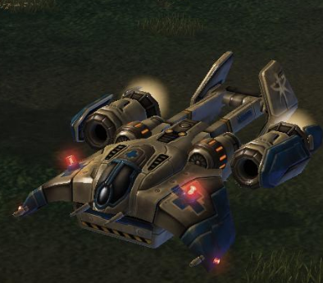
New task
marine can cause damage
only damage source in this sc2 minigame
can be “produced” by mineral
medivac
move faster
cannot attack
be able to heal the injured marines
Initial troop:
10 marines & 2 medivac
ShanghaiTech CS181 Final project

Slide 7
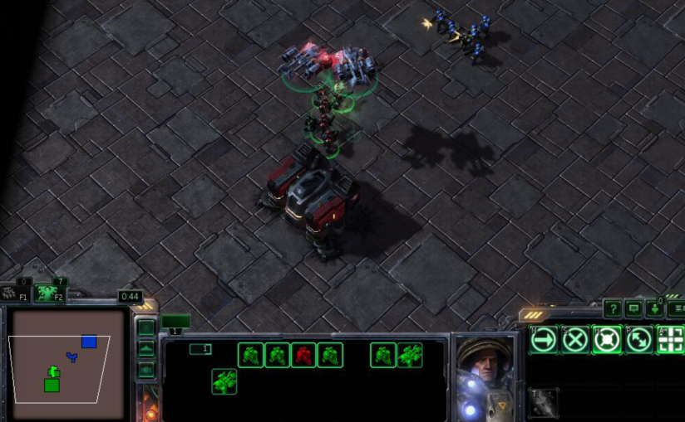
New task
Still many challenges
attack-or-train tradeoff
shall AI focus on operations to attack others or train a new marine to enhance your troop
marine-or-medivac dilemma
kill a marine can reduce other’s damaging power
Kill medivac can reduce other troop’s endurance
ShanghaiTech CS181 Final project

Slide 8
Our contribution
Provide a PVP mini-game map basing on pysc2 API.
Apply baseline DQN
Handle the large action space
ShanghaiTech CS181 Final project

Slide 9
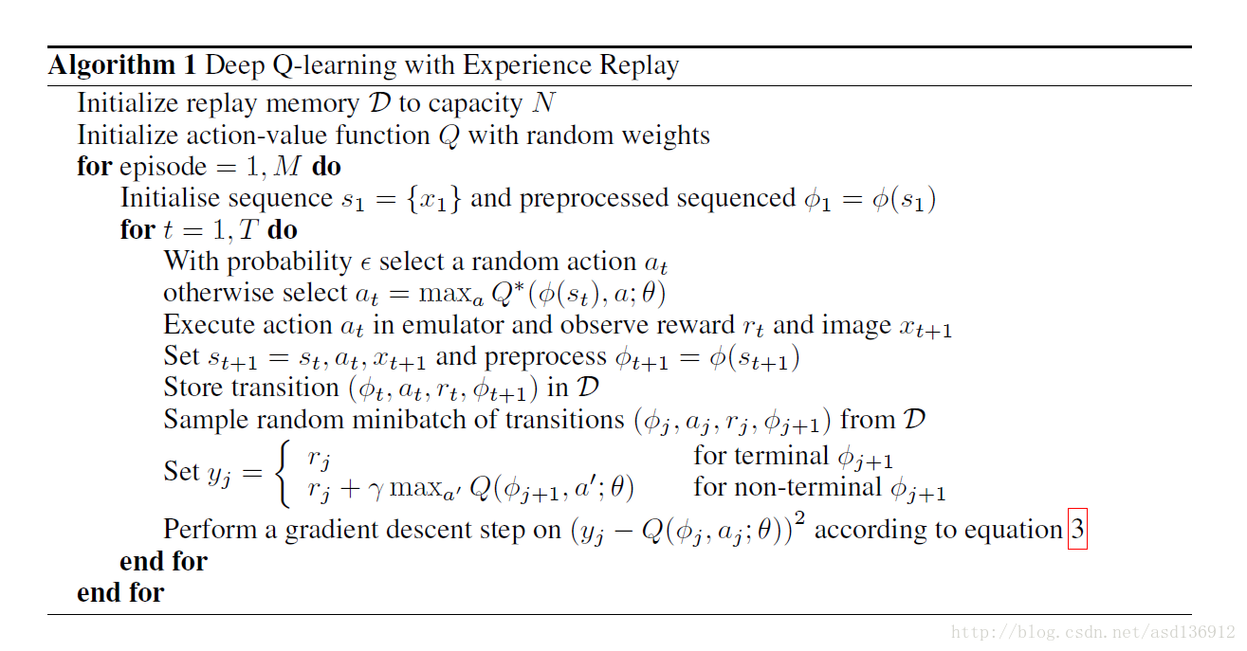
DQN Overview
Q approximation function
In DQN is a neuro network
Let’s first focus on the establishment
Of our neuro network
From DeepMind, Playing Atari with Deep Reinforcement Learning,2013
ShanghaiTech CS181 Final project

Slide 10

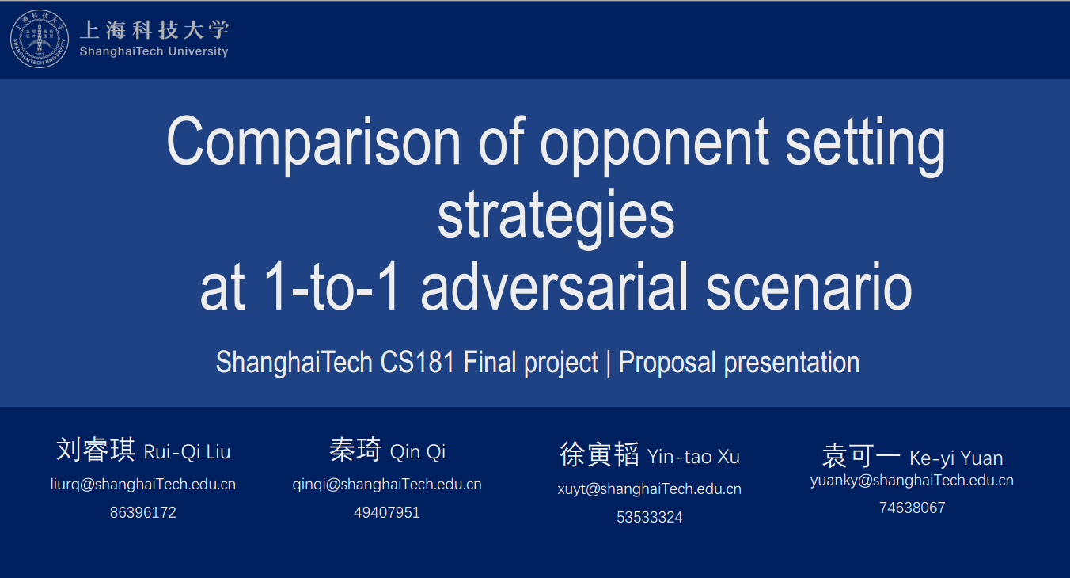
Motivation
Action: a
Policy 2: self-game
AlphaGo zero opponent setting policy
Agent
Environment
fork
Agent
State: s
Reward: r
one training step
ShanghaiTech CS181 Final project

Slide 11
Network architecture
Inputs:
1-D input[63x1]
current minerals
count of army
environment reward
20x3 selected unit information
2-D minimap information [64x64x3]
camera
player-relative information [hostile/relative]
selected unit info
3. 2-D screen information [84x84x8]
visibility
…
Fully-connected feature
screen
minimap
ShanghaiTech CS181 Final project

Slide 12
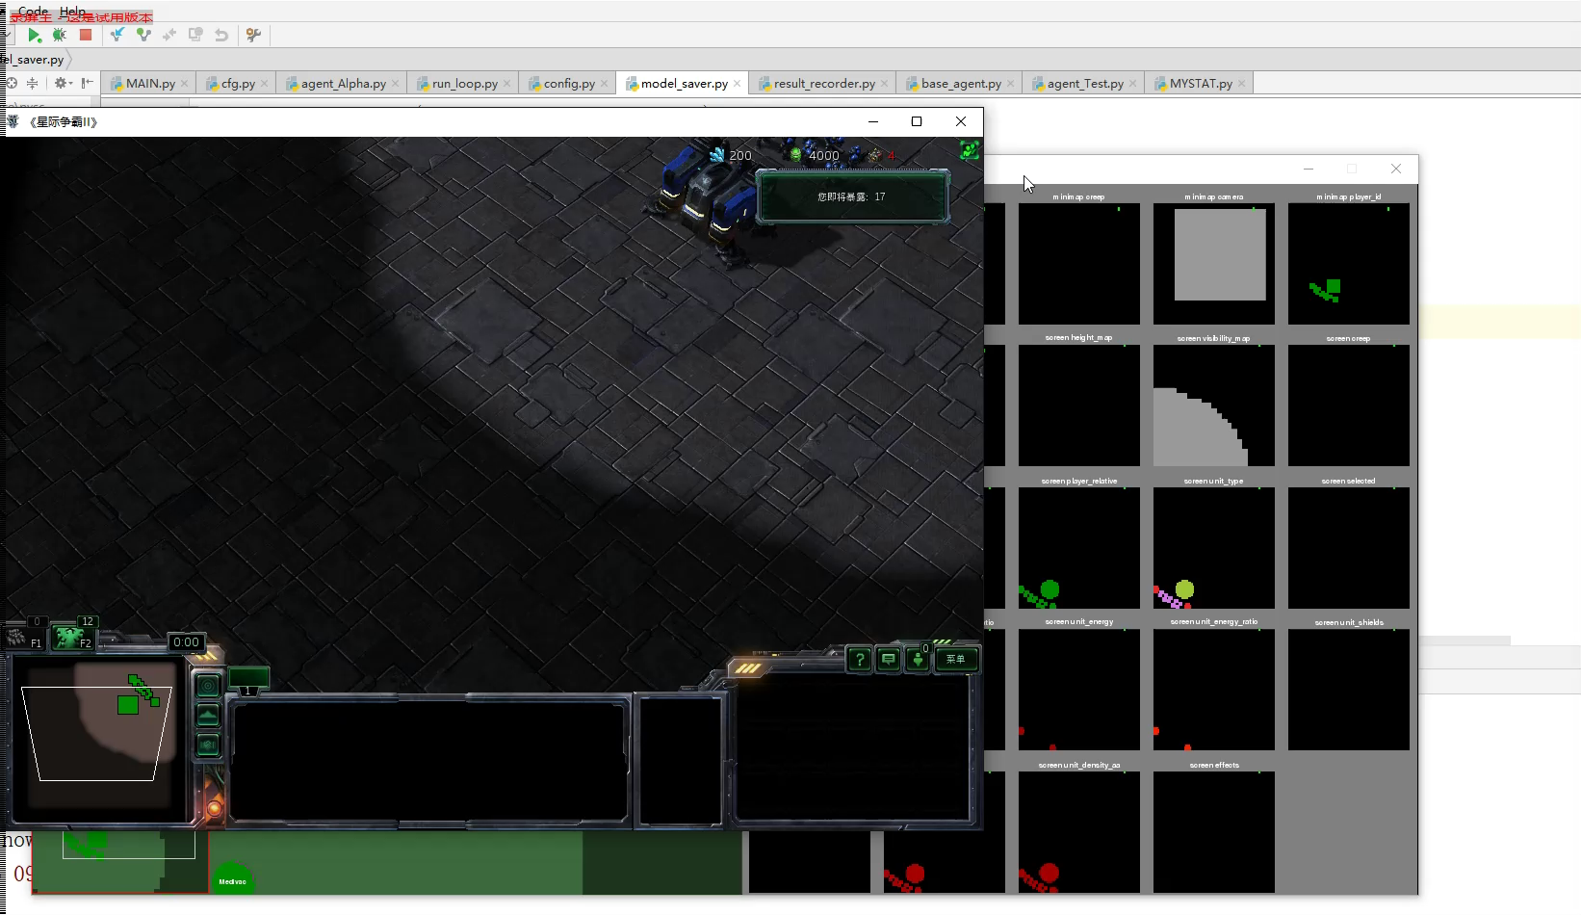
Experiment result
Episode 1
No command of spatial info
(the upper player hardly move)
No knowledge of who I am
Simply attack other’s base
Remedy: switch side of training
periodically
ShanghaiTech CS181 Final project

Slide 13
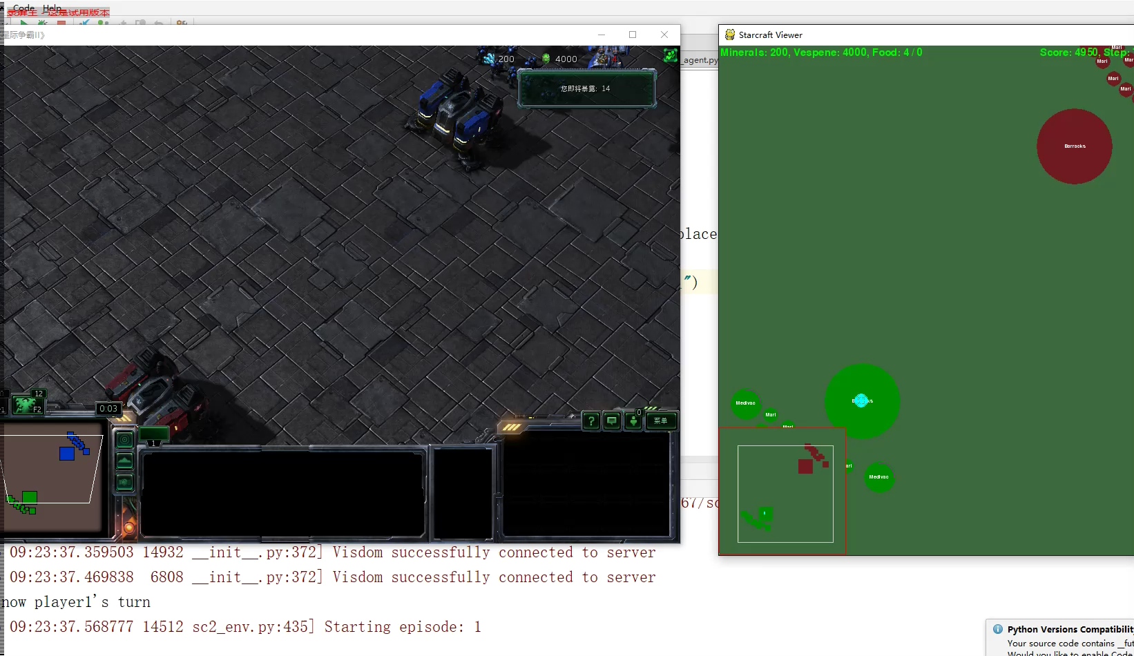
Experiment result
Episode 100
More conservative
ShanghaiTech CS181 Final project

Slide 14
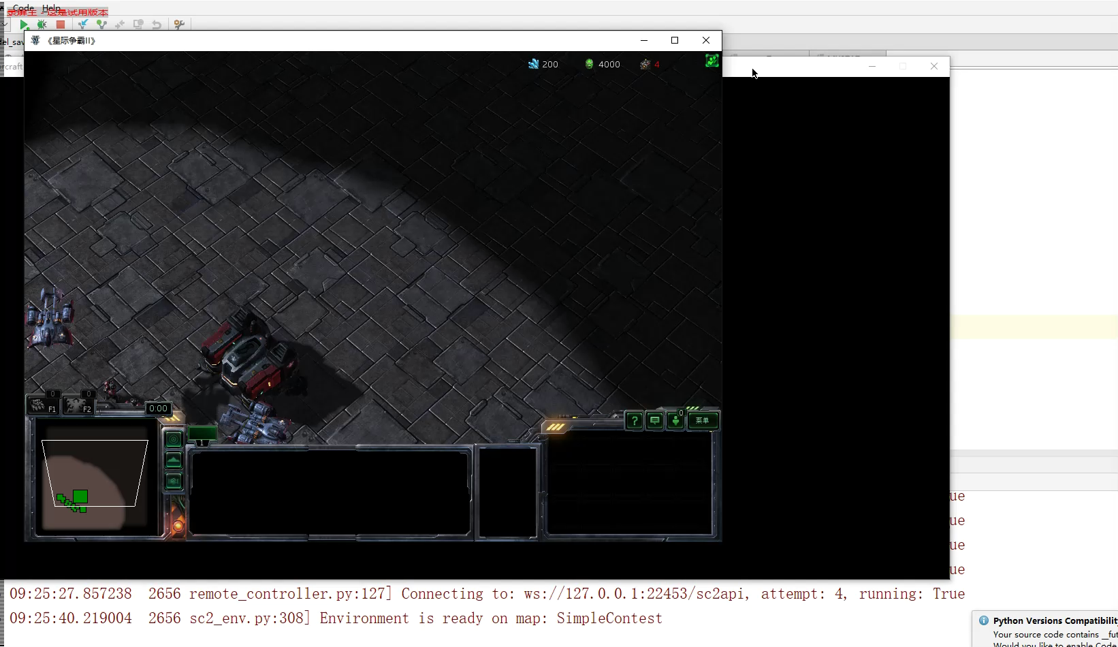
Experiment result
Episode 200
More technical
Attack
Learn how to train
ShanghaiTech CS181 Final project

Slide 15
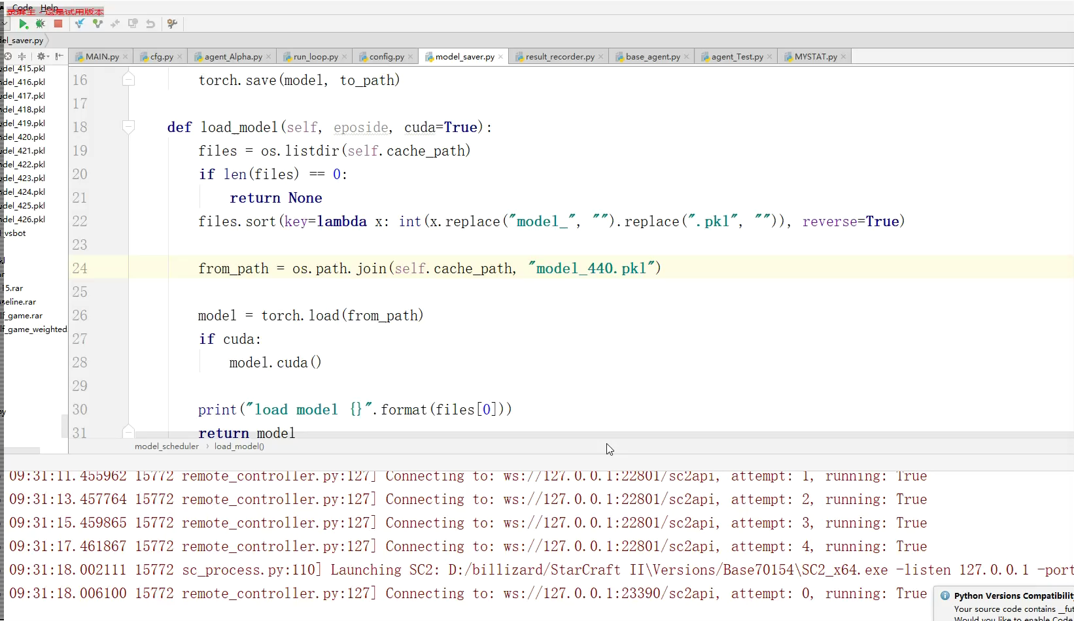
Experiment result
Episode 440
More fluent
More diversity of policies
ShanghaiTech CS181 Final project

Slide 16
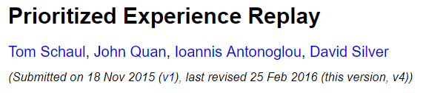

Other tricks
Prioritized Experience Replay
Sampled by weight instead of uniformly.
Similar to explore function in lecture.
My Implementation：
Update weight of sample when it is selected to be trained
Epsilon-greedy method: w.p of $ε$，it picked sample in replay repository w.p. ∝ weight(by some function); w.p of 1-$ε$, it still pick sample randomly
Explore function(weight):
$$\frac{last training loss}{\#learned time+1}$$
Motivation from, but not the same.
ShanghaiTech CS181 Final project

Slide 17

Other tricks
Periodic Epsilon-greedy(not recommended)
Motivation: we require consistency of operation in playing RTS game. Randomness of a trivial operation may not provide enough heuristics for exploration
My Implementation：
Two mode: sanity mode and random mode
In sanity mode, it pick action with largest Q value; Otherwise, act randomly
With some probability $ε$，switch to random mode; Otherwise, switch to sanity mode
ShanghaiTech CS181 Final project

Slide 18
Our contribution
Provide a PVP mini-game map basing on pysc2 API.
Apply baseline DQN
Handle the large action space
ShanghaiTech CS181 Final project

Slide 19

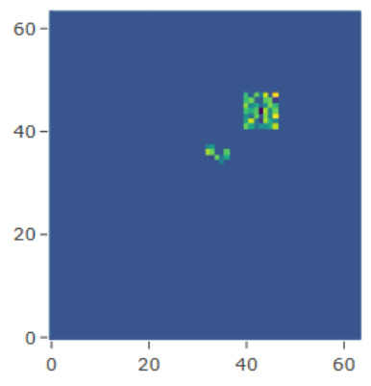

Network architecture
Output:
Huge action space(a lot of Q values):
no operator
Move camera([0~63], [0~63])
…
First, reframe it as a tree
Move camera
Attack
Minimap
…
Challenge:
Huge amounts of Q-value.
From POV of tree, there are $O(b^{d})$ Q-value(leaves),
where d is the depth of the tree, b is the maximum branch factor
b=84*84=7056, d=3, O(~3.51x${10}^{11}$) operations
Cannot be produced end-to-end by network
queued?
Choose a point
Choose a point
ShanghaiTech CS181 Final project

Slide 20

Network architecture
Challenge:
Huge amounts of Q-value.
From POV of tree, there are $O(b^{d})$ Q-value(leaves),
b=84*84=7056, d=3
Move camera
Attack
Minimap
…
My new implementation:
(TQGP) tree-leveled Q-value generating process
Intuition: network outputs importance value(IV), average the same importance but different semantics IV, promote parallel IVs, promote and average low levels IVs to its parent’s IVs to compute a multi-leveled action. Top-level IV is Q-value
queued?
Get from applying network on
env.
Choose a point
Choose a point
ShanghaiTech CS181 Final project

Slide 21
Tree-leveled Q-value generating process
My implementation:
(TQGP) tree-leveled Q-value generating process. A method to handle large action space.
Network:
State -> Importance value (IVs).
TQGP:
(IVs, tree)->Q-Values
Three operations of TQGP:
(1) promote (2) average (3) promote and average
Attack
Minimap
queued?
Example:
Compute Q-value of the operation
Attack to (10, 10) in screen and not queued
Sc2 allows queued operation (there is a FIFO queue for attack move)
Choose a point
ShanghaiTech CS181 Final project

Slide 22
Tree-leveled Q-value generating process
Example:
Compute Q-value of the operation
Attack to (10, 10) in screen and not queued
Sc2 allows queued operation (there is a FIFO queue for attack move)
Task1: find IV of choose a point(to attack)
Promote
Intuition: the importance of choosing all points are the same.
Details:
Network outputs a=[84x84] IVs for choosing a point to move camera, promote a[10, 10] since we’re going to compute Q-value of the operation w.r.t. to attack [10,10] on the screen
Similarly, we can pick whether to queued by promote operation.
Choose a point
ShanghaiTech CS181 Final project

Slide 23


Tree-leveled Q-value generating process
Example:
Compute Q-value of the operation
Attack to (10, 10) in screen and not queued
Sc2 allows queued operation (there is a FIFO queue for attack move)
Attack
Minimap
$$avg$$
Task2: find IV the whole operation
$$avg$$
(2) Promote
Intuition: the importance of choosing a point are the same and whether to queue roughly contain similar level of semantics(w.r.t. whether to attack such a general idea)
Details:
Average IV of whether to queue and IV of picking a point
queued?
ShanghaiTech CS181 Final project

Slide 24
Tree-leveled Q-value generating process
Example:
Compute Q-value of the operation
Attack to (10, 10) in screen and not queued
Sc2 allows queued operation (there is a FIFO queue for attack move)
Attack
Minimap
$$avg$$
Task2: find IV the whole operation
$$avg$$
(3) Promote and average
Intuition: details(picking a point, whether to queue) and general ideas(whether to attack) shares the same importance. Promote IV of the set of details (gained by average) and to take average with higher level. Their relationship in three is parent and children
Details:
Average IV of whether to attack minimap with the average of picking a point and whether to queue. Set it as the IV of attack minimap. Now we are at top of the semantic level in tree(except the dummy root). It is the Q-value!
queued?
ShanghaiTech CS181 Final project

Slide 25



Tree-leveled Q-value generating process
Example:
Compute Q-value of the operation
Attack to (10, 10) in screen and not queued
Sc2 allows queued operation (there is a FIFO queue for attack move)
Compute graph
state
Attack
Minimap
$$avg$$
Big formula
$$avg$$
Network
$$\frac{\left(A\left[10, 10\right]+q\left[false\right]\right)/2+ {IV}_{attack}}{2}$$
queued?
A[84x84]
Fact: It is a convex combination of IVs.
Engineering hint: If you keep all IV in the same scaling, the final Q value is in the same scaling, which helps converge.
q[2]
ShanghaiTech CS181 Final project

Slide 26
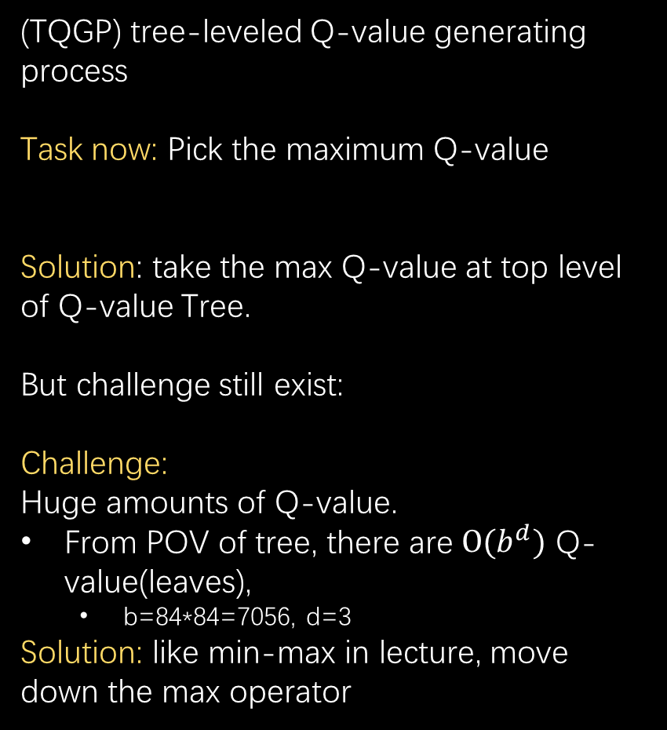
Tree-leveled Q-value generating process
(TQGP) tree-leveled Q-value generating process
Task now: Pick the maximum Q-value
Solution: take the max Q-value at top level of Q-value Tree.
But challenge still exist:
Challenge:
Huge amounts of Q-value.
From POV of tree, there are $O(b^{d})$ Q-value(leaves),
b=84*84=7056, d=3
Solution: like min-max in lecture, move down the max operator
Move camera
Attack
Minimap
…
queued?
Choose a point
Choose a point
ShanghaiTech CS181 Final project

Slide 27

Tree-leveled Q-value generating process
Task now: Pick the maximum Q-value
Solution: take the max Q-value at top level of Q-value Tree. Like min-max in class, move down the max operator.
Math trick here, for some set A:
$$\max_{b,d∈A}\left(ab+cd\right)=a·\max_{b∈A}\left(b\right)+c·\max_{d∈A}(d)$$
s.t: a, c > 0
“max can transfer on convex combination”
Average is a special convex combination
state
Attack
Minimap
$$avg$$
$$avg$$
Network
queued?
A[84x84]
q[2]
ShanghaiTech CS181 Final project

Slide 28

Tree-leveled Q-value generating process
(TQGP) tree-leveled Q-value generating process
Pros:
Max only appear on average operator “layer” and top dummy layer, the time complexity reduce to $O(bd)≈$ O(21,168).
Encode prior knowledge of decision into tree architecture .
Output of network is also $O(bd)$ now
In practice, 54,652 in our setting.
Motivations
min-max pruned
decision tree
Move camera
Attack
Minimap
…
queued?
Choose a point
Choose a point
ShanghaiTech CS181 Final project

Slide 29
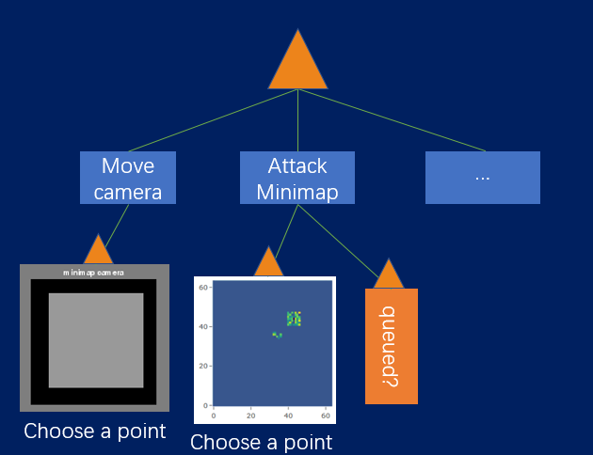
Network architecture
Memoryless
Magic black
Network Box
(details in report,
Too trivial to explain)
63
28
64x64x3
64x64x3
84x84x8
84x84x6
input
output
action
TQGP
ShanghaiTech CS181 Final project

Slide 30
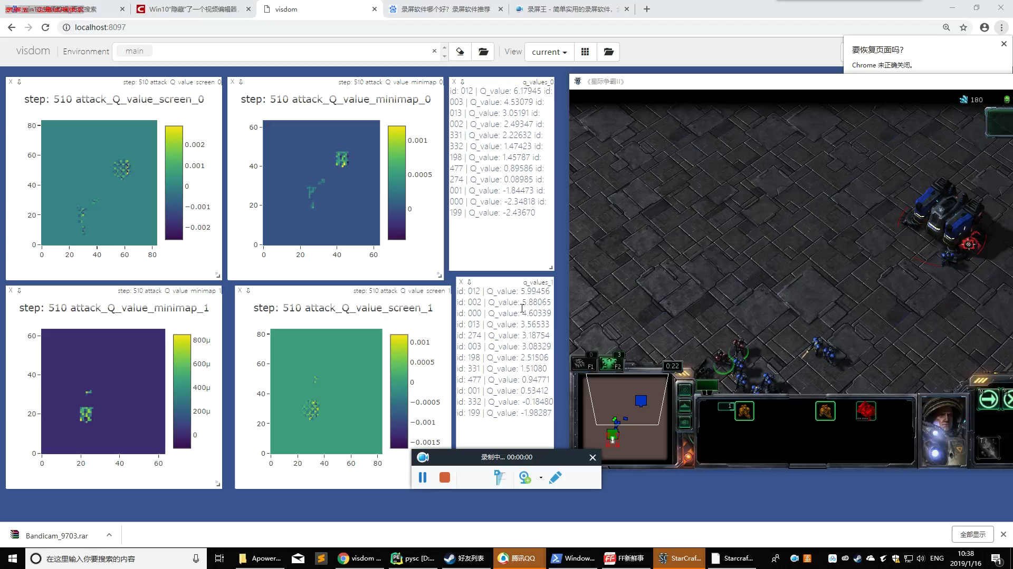
Experiment result
ShanghaiTech CS181 Final project

Slide 31
Network architecture
Remarks:
Why memoryless?
For this sc2 mini-task, the state sequence may be ~2000 long, classical method is impossible to compute(OOM).
One possible remedy is to hard code memory.(e.g.: output Q values by exponentially average the IV in TQGP)
Memoryless
Magic black
Network Box
(details in report,
Too trivial to explain)
ShanghaiTech CS181 Final project

Slide 32
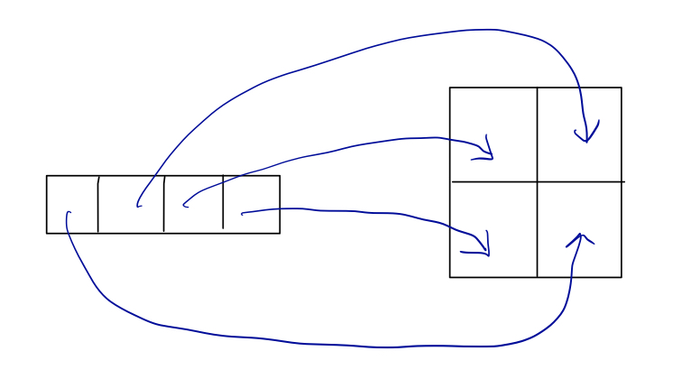
Network architecture
Remarks:
2. Any novelty?
One key problem is how to combine 1-D info(money, selected units) with 2-D info(minimap screen).
Popular method: reshape fc layer into convolutional layer.
Problem: fc does not contain spatial structure in architecture(require “learning” the structure). Huge amounts of parameter and learning cost.
Memoryless
Magic black
Network Box
(details in report,
Too trivial to explain)
ShanghaiTech CS181 Final project

Slide 33
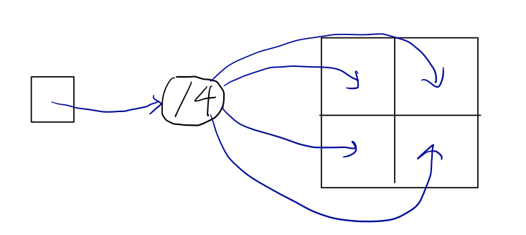
Network architecture
Remarks:
2. Any novelty?
One key problem is how to combine 1-D info(money, selected units) with 2-D info(minimap screen).
Our implementation: fork the fc feature into 2-D structure
Memoryless
Magic black
Network Box
(details in report,
Too trivial to explain)
Engineering trick: divided fc value by forked num. to avoid gradient explosion
(Or NaN will come to find you!)
ShanghaiTech CS181 Final project

Slide 34
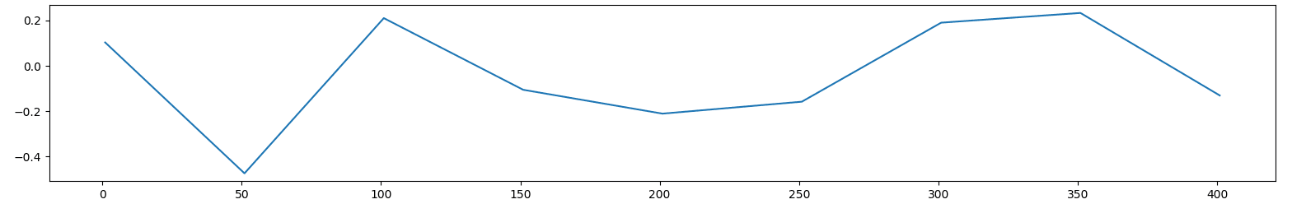
Experiment result
Training takes ~2 days, with ~400 epoxides(games) on GTX1080Ti
Speed: ~5fps
Compete with models with previous epoxides randomly(~20 matches),
Pick the best model.
ShanghaiTech CS181 Final project

Slide 35
Experiment result
Ternary score: +1 win, -1 lost, 0 tie
RL vs. Bot(Easy in sc2) | RL vs. Random | RL vs. RL(pool)
-0.8 | 0.7 | 0.2
Hard-code robot takes better attack action:
attack one unit with consistency, where out robot(memoryless) cannot,
which determines the game.(Bright future for a model with memory ☺)
ShanghaiTech CS181 Final project

Slide 36

Summary
Provide a PVP mini-game map basing on pysc2 API.
well-designed rewards
well-designed performance measurement metric
Apply baseline DQN
self-game setting
Tricks1: prioritized Experience Replay
Tricks2: periodic epsilon-greedy(×)
Handle the large action space
TQGP(tree-leveled q-value generating process)
Fork layer design details
Follow our project on GitHub!
AI-StarCraft-II
ShanghaiTech CS181 Final project

